Slide 1
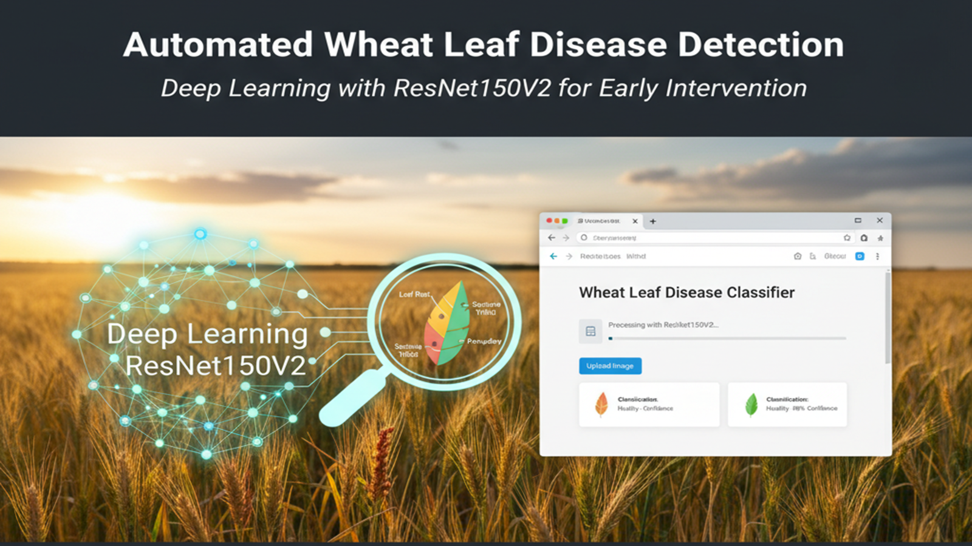
By:
Yash Sunil patil
Rohit patil
Shivam soni
Adarsh kumar

Slide 2

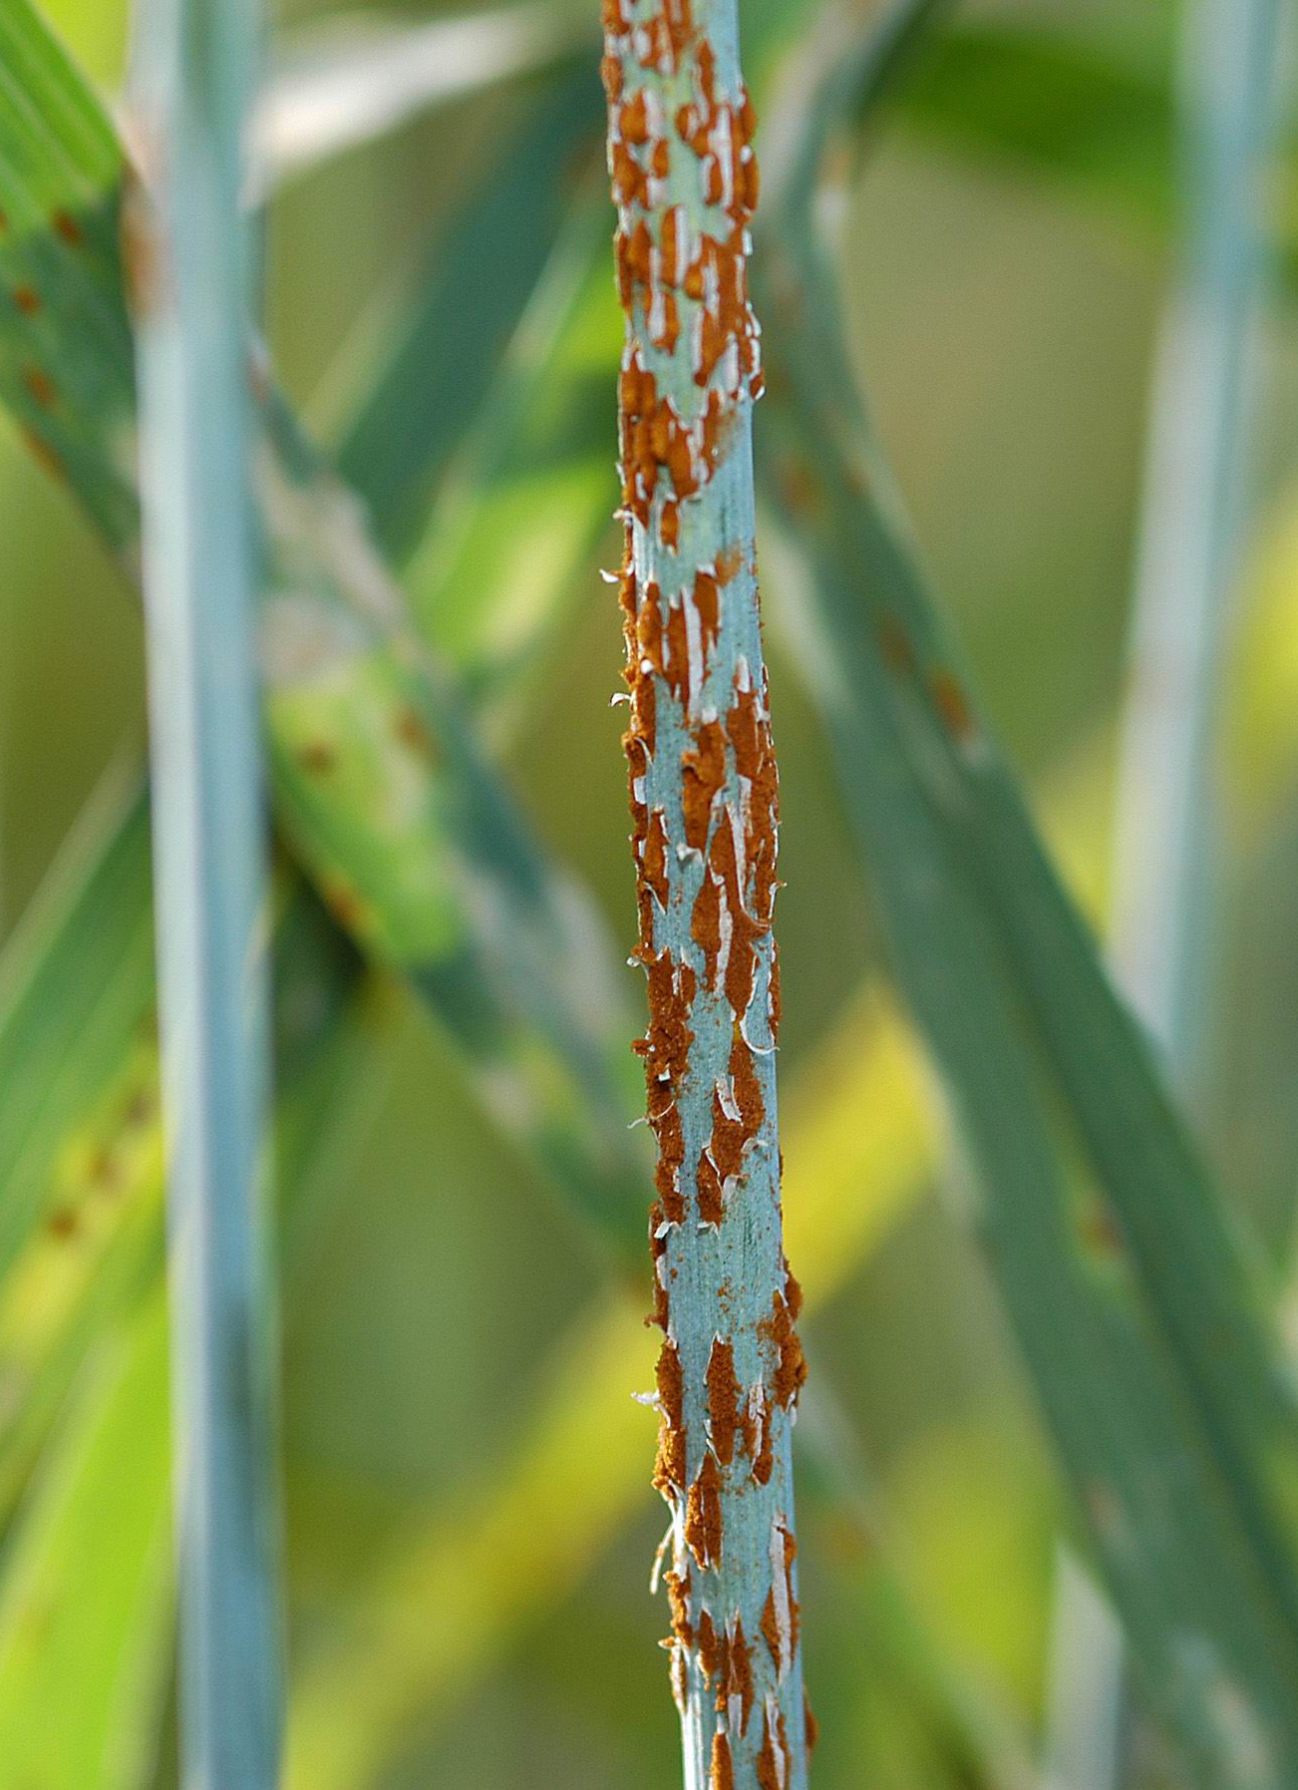
Problem Statement
Agricultural Challenge: Wheat diseases cause significant yield losses
Manual Detection: Time-consuming and requires expert knowledge
Need: Automated, accurate disease identification system

Slide 3
Project Overview
Objective: Develop a system to classify wheat leaf diseases
Target Diseases:
Fusarium Head Blight
Leaf Rust
Tan Spot
Healthy Wheat
Dataset Size: ~4000+ images across 4 classes

Slide 4


Technical Architecture
Deep Learning Model: ResNet50 (Transfer Learning)
Framework: TensorFlow/Keras
Image Processing: OpenCV
Web Interface: Flask (Python)
Input Size: 224x224 pixels

Slide 5
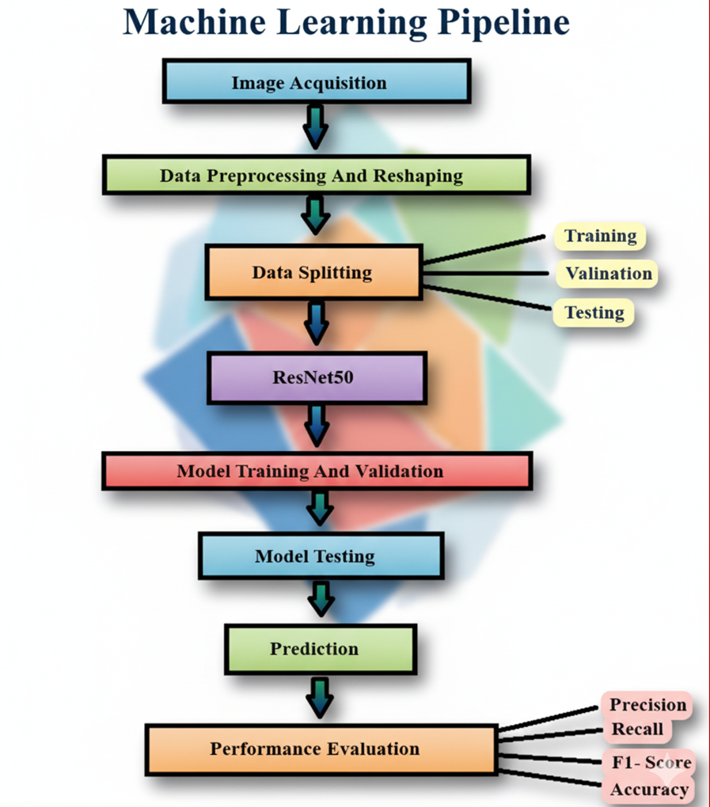
Implementation

Slide 6
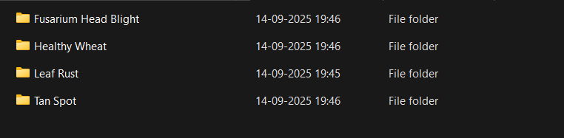
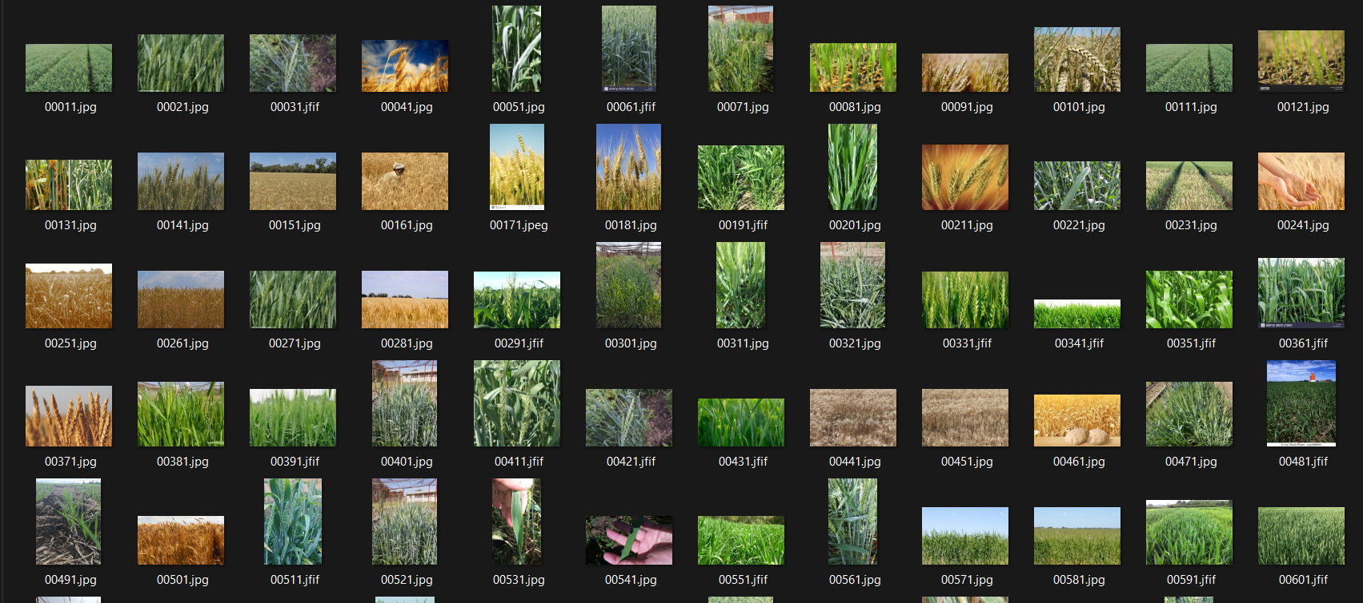
Dataset and Preprocessing
Data Augmentation: Rotation, zoom, shift, flip
Preprocessing: RGB conversion, normalization
Train/Test Split: 75/25 ratio
Classes Distribution: Balanced dataset

Slide 7
Results and Performance
Overall Performance:
Overall Accuracy: 85.00% (170/200 correct predictions)
Mean Confidence: 90.06%
Key Insights:
1. Best Performance: Leaf Rust (92.73% accuracy)
2. Most Challenging: Tan Spot (75.00% accuracy)
3. High Confidence: 78.5% of predictions had ≥80% confidence
4. Strong Correlation: Correct predictions had higher confidence (93.37%) than incorrect ones (71.27%)
Disease Class | Precision | Recall | F1-Score | Support | Accuracy
Fusarium Head Blight | 97.37% | 80.43% | 88.10% | 46 | 80.43%
Healthy Wheat | 66.15% | 91.49% | 76.79% | 47 | 91.49%
Leaf Rust | 91.07% | 92.73% | 91.89% | 55 | 92.73%
Tan Spot | 95.12% | 75.00% | 83.87% | 52 | 75.00%

Slide 8
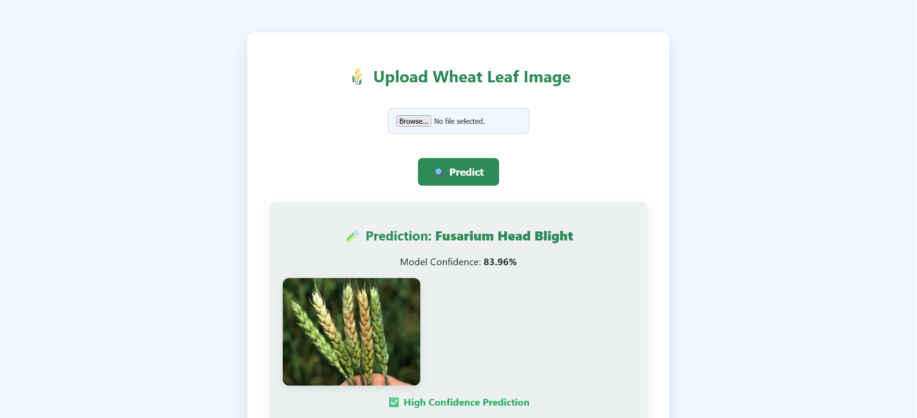
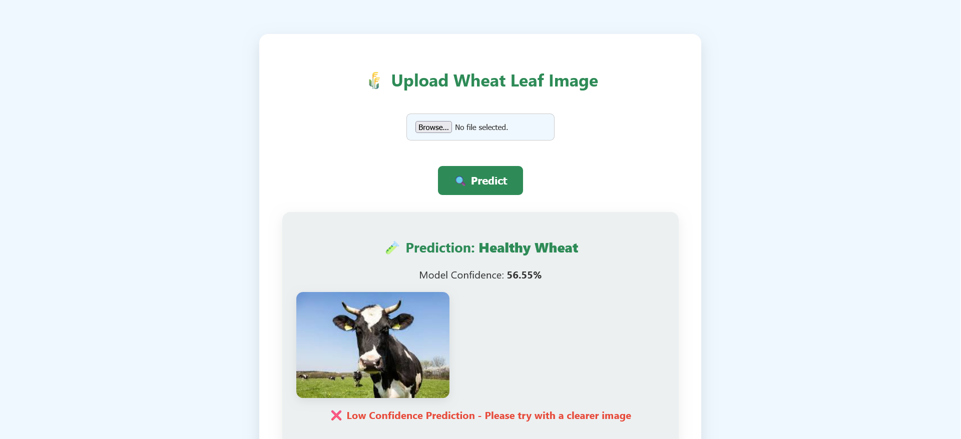
Web Application
User Interface: Clean, responsive design
Image Upload: Drag & drop functionality
Real-time Prediction: Instant disease classification
Confidence Display: Visual confidence indicators

Slide 9
Impact and Applications
Farmers: Early disease detection
Researchers: Agricultural studies
Food Security: Improved crop yields
Cost-effective: Reduces expert consultation needs

Slide 10
THANK YOU

